Slide 1


End-to-End Quality Assurance for a Web-Based Application
Manual Testing | API Testing | Performance | Automation | CI
Yara Alzaghah
ICT Upskilling Program – QA Track

Slide 2
Presentation Agenda
  Problem and Use Case
  End-to-End QA Workflow
  Manual Testing Overview
  Manual Test Cases and Execution Summary
  Defects Overview
  API Testing using Postman Collection and Assertions
  API Automation using Newman
  API Performance Testing using k6
  UI Automation using Selenium and TestNG
  Github and CI workflow

Slide 3
Problem and Use Case
  The Problem:
  Manual testing alone is not enough
  Bugs appear across UI, API, and performance layers
  Use Case:
  Web based e-commerce system
  Frontend and backend APIs

Slide 4
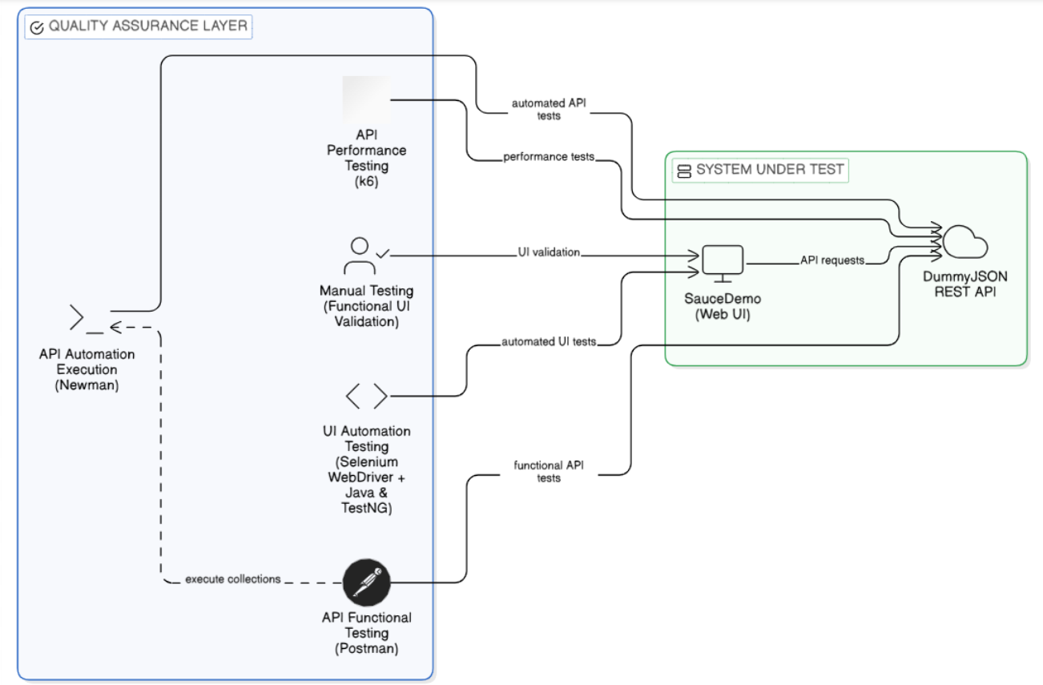
End-to-End QA Workflow

Slide 5
Manual Testing Overview
  Happy and negative user scenarios
  Core user flows (login, products, cart, checkout)
  Multiple user types tested
  Manual execution before automation.

Slide 6
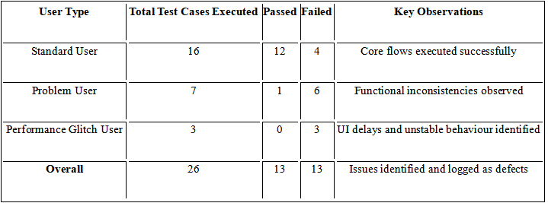
Manual Test Cases and Execution Summary
- Sample Manual Test Case -
- Executive Summary -

Slide 7
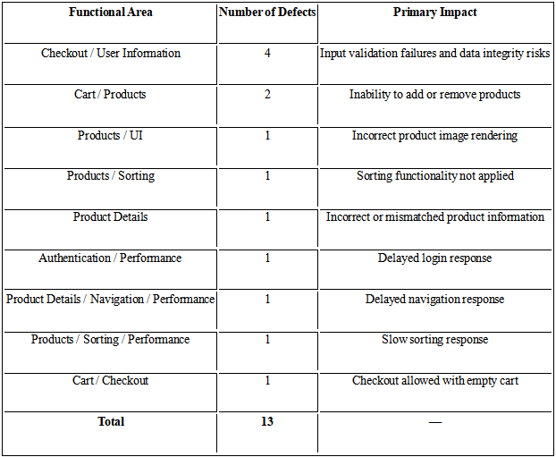
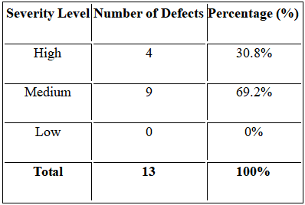
Defects Overview
- Defect Distribution by Functional Area -
- Defect Severity Distribution -

Slide 8
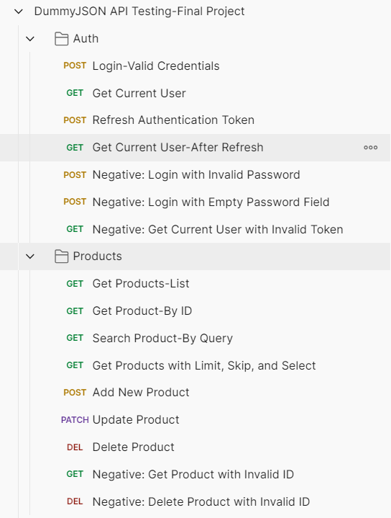
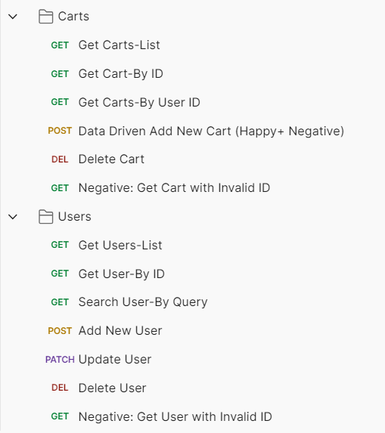
API Testing using Postman Collection and Assertions
  Structured collection
  (Auth / Users / Products / Carts)
  Automated assertions
  (status, JSON fields, response time)
  Environment variables + reusable test data
- Postman API Collection Structure -

Slide 9
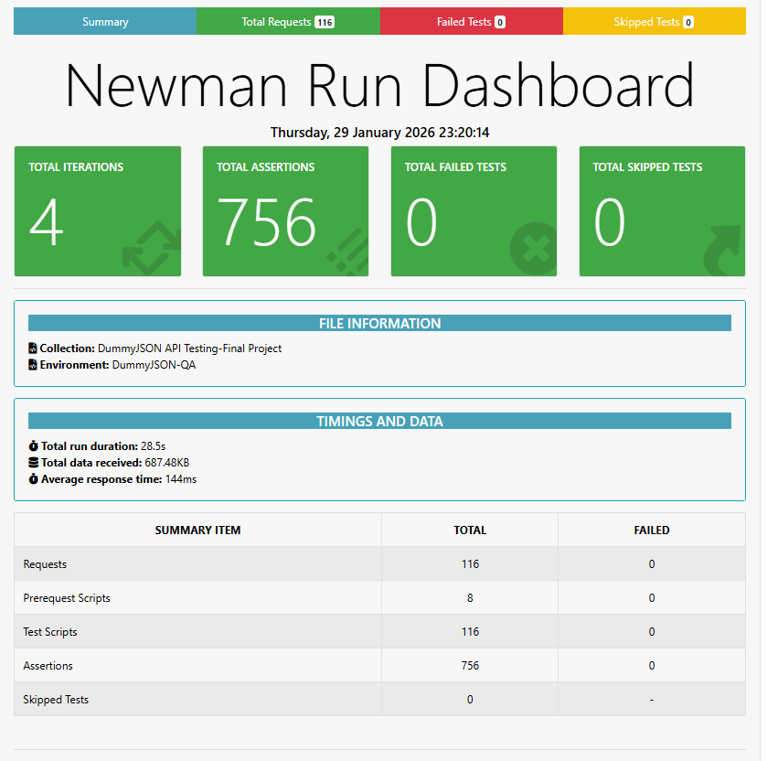
API Automation using Newman
- Newman HTML Execution Report Summary -

Slide 10
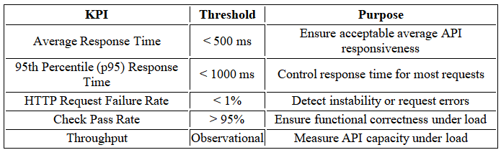
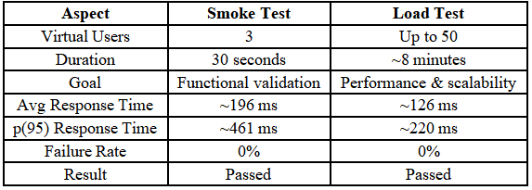
API Performance Testing using k6
- Defined Performance KPIs and Thresholds -
- Smoke Test vs Load Test Results -

Slide 11
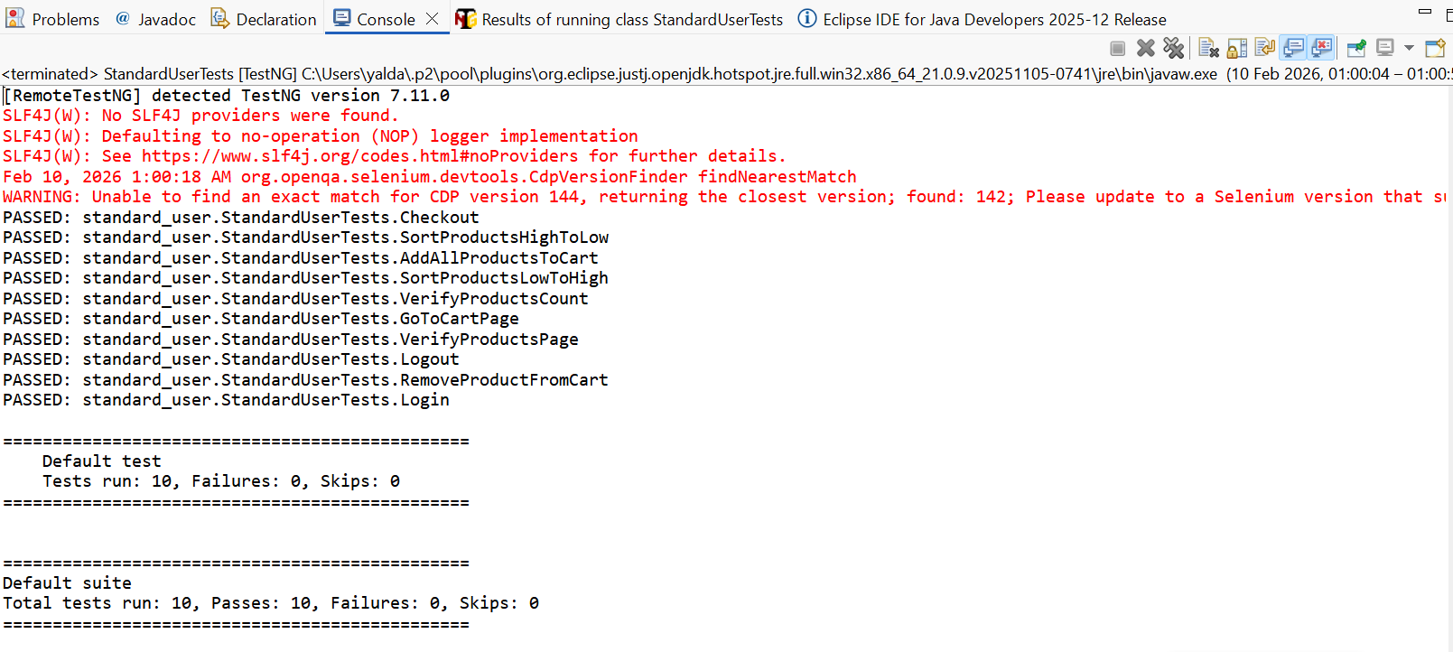
UI Automation using Selenium and TestNG
- UI Automation Execution Results Using TestNG -

Slide 12

GitHub and CI Workflow
  Structured project repository
  Version control with meaningful commits
  Branching and pull requests
  CI with GitHub Actions
  Automated test reports as artifacts

Slide 13
Thank You for Your Time and Attention

